Slide 1
OO Programming and S.O.L.I.D.
Making software “more understandable, flexible and maintainable”- Wikipedia

Slide 2
What is the worst bug you ever had to fix?

Slide 3
History
First 30(ish) years of programming:
Mistrust of open source software:
Driven by FUD (fear, uncertainty and doubt) spread by big companies like Microsoft
Internet was still growing:
Book and school learning only
No stackoverflow.com
No way to find reliable information on quality of APIs / libraries
Everyone writing their own software in their own ways
Gang of Four (Erich Gamma, Richard Helm, Ralph Johnson, John Vlissides):
Design patterns (mid 90’s)
Refactoring: Improving the Design of Existing Code (Fowler) (1999)
Internet exploded, people started talking about doing things in better ways, fear of open source software and re-use rather than reinventing the wheel dissipated.

Slide 4
Now - Most companies:
Constantly strive to write no code
Every time you write code is an investment, a choice between two paths that has a cost to change
Every time you write code, you have the potential for introducing bugs, bugs cost time (and therefore money, maybe a little or maybe a lot)
Ensure the code they do write is very high quality:
Remember this is probably the company’s primary asset. It must be:
Understandable:
Eliminate “tribal knowledge” and specialists, keep code simple and understandable so that anyone can work on it. This is key to agile responsiveness.
Flexible:
Make it as easy as possible to choose alternate paths and directions, to adapt to change
Maintainable:
Make it easy to find and fix bugs

Slide 5

Procedure programming
What is the problem?
Examples
Almost failed on every aspect of expectation of software dev (Understandability , Flexibility, Maintainability )

Slide 6

Why Is Understandability Important?
Having “specialists” in your company is a violation of agile methodology

Slide 7
Understandability
Easier maintenance and debugging: Developers can more quickly identify and fix issues, reducing the time spent on maintenance and debugging.
Effective collaboration: When developers can quickly grasp the purpose and functionality of code written by others, they can more effectively contribute to the project and communicate about potential issues or improvements.
Onboarding new team members: If the code is well-structured and easy to understand, new developers can quickly become productive, reducing the time and cost associated with getting up to speed.

Slide 8
Understandability (Cont.)
Easier refactoring and extension: Understandable code makes it easier to refactor or extend the software to meet changing requirements or add new features.
Longevity and adaptability: Understandable code is more likely to stand the test of time, as it can be maintained and updated more easily.
Better documentation: When code is self-explanatory and well-documented, developers can more easily understand the reasoning behind design decisions and the intended functionality of the software.

Slide 9
Why Is Flexibility Important?
Without flexibility your codebase (and your company) become chained to any bad decisions you’ve made
Cost overwhelms ability to change, forcing the company to keep limping along (Sears, Blockbuster)
Like a tumor in your body, the rigidity grows and pollutes other systems that depend on the rigid module making them rigid too
Future projects inherit a legacy of almost immutable pain and hardship, they must pick one of two bad options: reuse the bad, or start from scratch
Flexibility is a shield against the unknown, leaving your company ready and able to jump on any opportunity that comes along
If a codebase is flexible, that codebase is probably also very high quality across the board, because of the discipline it takes to maintain flexibility

Slide 10
Flexibility
Evolving requirements and faster feature development: Flexibility enables software to accommodate changing requirements and implement new features more quickly, reducing time and cost associated with updates.
Scalability and adaptability: Flexible software can more easily scale to meet increasing demands and adapt to new technologies, ensuring its continued viability and relevance.
Ease of maintenance and reduced technical debt: A flexible design facilitates easier maintenance and minimizes technical debt by promoting modularity, decoupling, and adherence to design principles.

Slide 11
Flexibility (Cont.)
Integration with other systems: Flexibility allows for easier integration with external systems or APIs, leveraging existing functionality or data without extensive rework.
Improved code reusability: Flexible software promotes code reusability, as modular components can be reused in different parts of the system or other projects, reducing development time and effort.
Long-term efficiency: Overall, flexible software results in long-term efficiency by streamlining development, maintenance, and adaptation processes, leading to reduced costs and improved software quality.

Slide 12
Maintainability
Maintainability is an essential attribute of all software, if software cannot be fixed when it is broken, or modified to add new functionality, it is worthless.
Debugging is extremely expensive:
Most programmers are bad at it
Some bugs are environmental, programmers can spend countless hours trying to catch/reproduce these
Bugs sap confidence in the system, QA must now dedicate more resources to verifying changes to the code that is difficult to maintain and error prone
Maintainability is usually a measure of flexibility, higher maintainability usually translates to easy to change

Slide 13
Maintainability (Cont.)
If code is difficult to maintain, it takes a long time to maintain:
Performing maintenance is not always a choice (e.g. software updates, OS updates, hardware updates, vendor changes, outages)
Your company may grind to a halt simply fighting back a wave of maintenance work
How far should you go to preserve maintainability? ALL THE WAY!

Slide 14
The 4 pillars of OO Programming

Slide 15
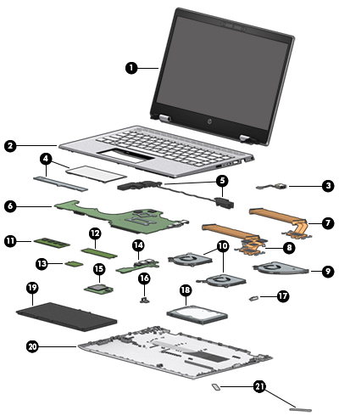

Encapsulation
Hiding the internal data and states of objects from the outside world, and only allowing access through methods. It ensures that the object's internal representation (its state and data) is hidden from the outside. This helps in maintaining the integrity of the data.

Slide 16
Encapsulation
Declare class variables as private: This ensures that the variables cannot be directly accessed from outside of the class. Only methods within the same class can directly access and modify these variables.
Provide public getter and setter methods: To allow other classes to interact with the private variables, provide public methods, often known as getter and setter methods. These methods allow other classes to view or modify the values of the variables.

Slide 17
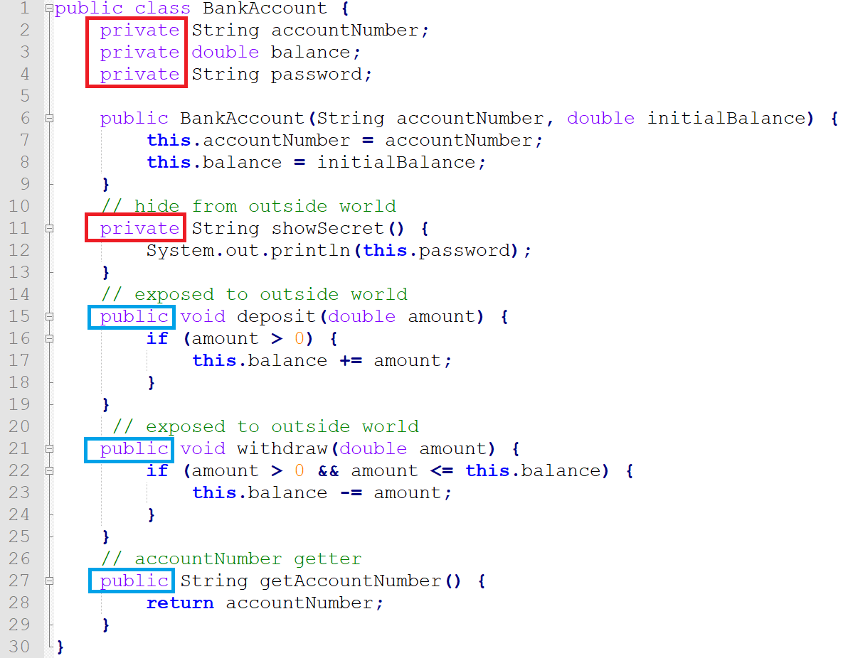

Slide 18
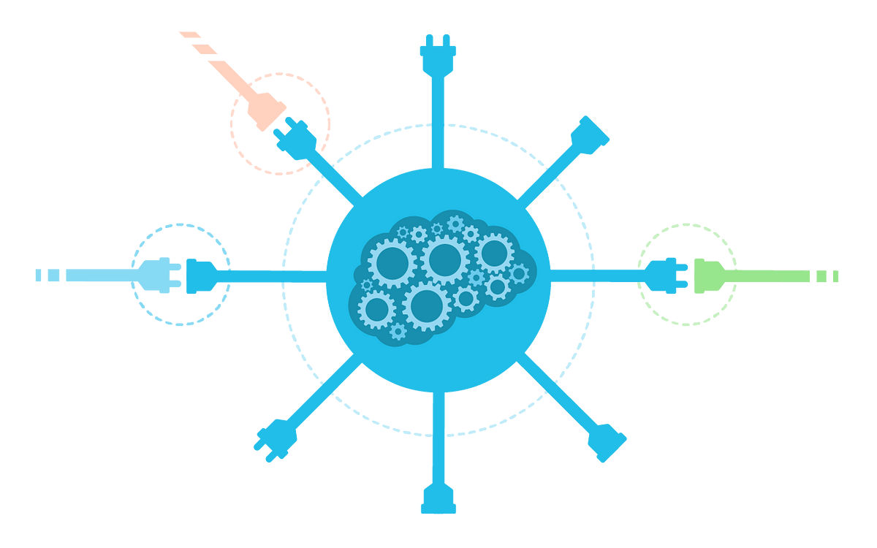
Abstraction
It's the process of hiding the implementation details from the user and only providing the functionality. In other words, the user knows what a method does but not how it does it.

Slide 19
Abstraction
Abstract classes: An abstract class in Java is a class that cannot be instantiated (you cannot create objects of an abstract class). It is designed to be extended by other classes. An abstract class can have both abstract methods (methods without bodies) and concrete methods (regular methods with bodies).
Interfaces: An interface in Java is a completely abstract entity that cannot have any implementation. It can only have method signatures (method names without bodies) and static final constants. Classes that implement an interface must provide an implementation for all its methods.

Slide 20
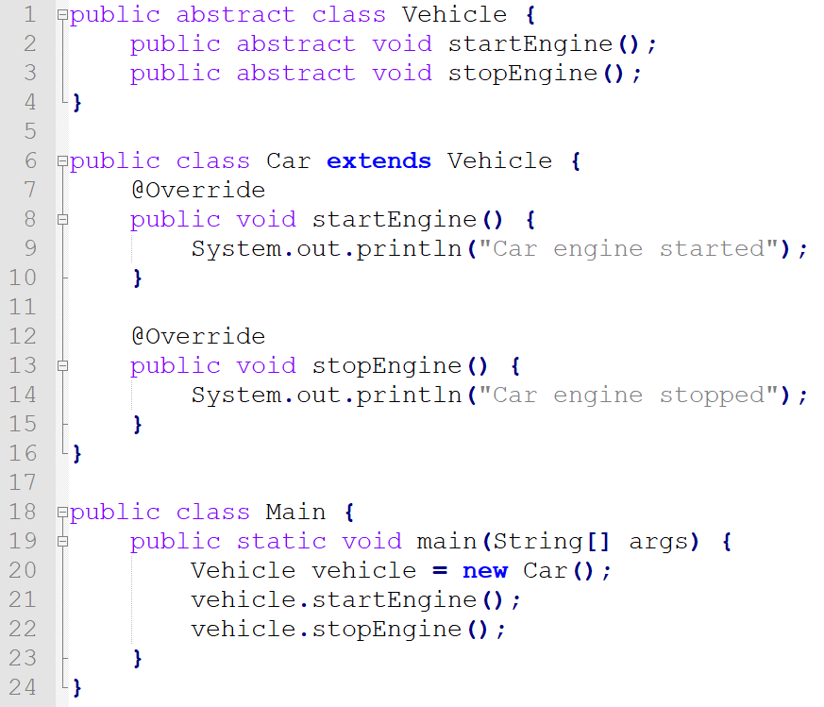

Slide 21
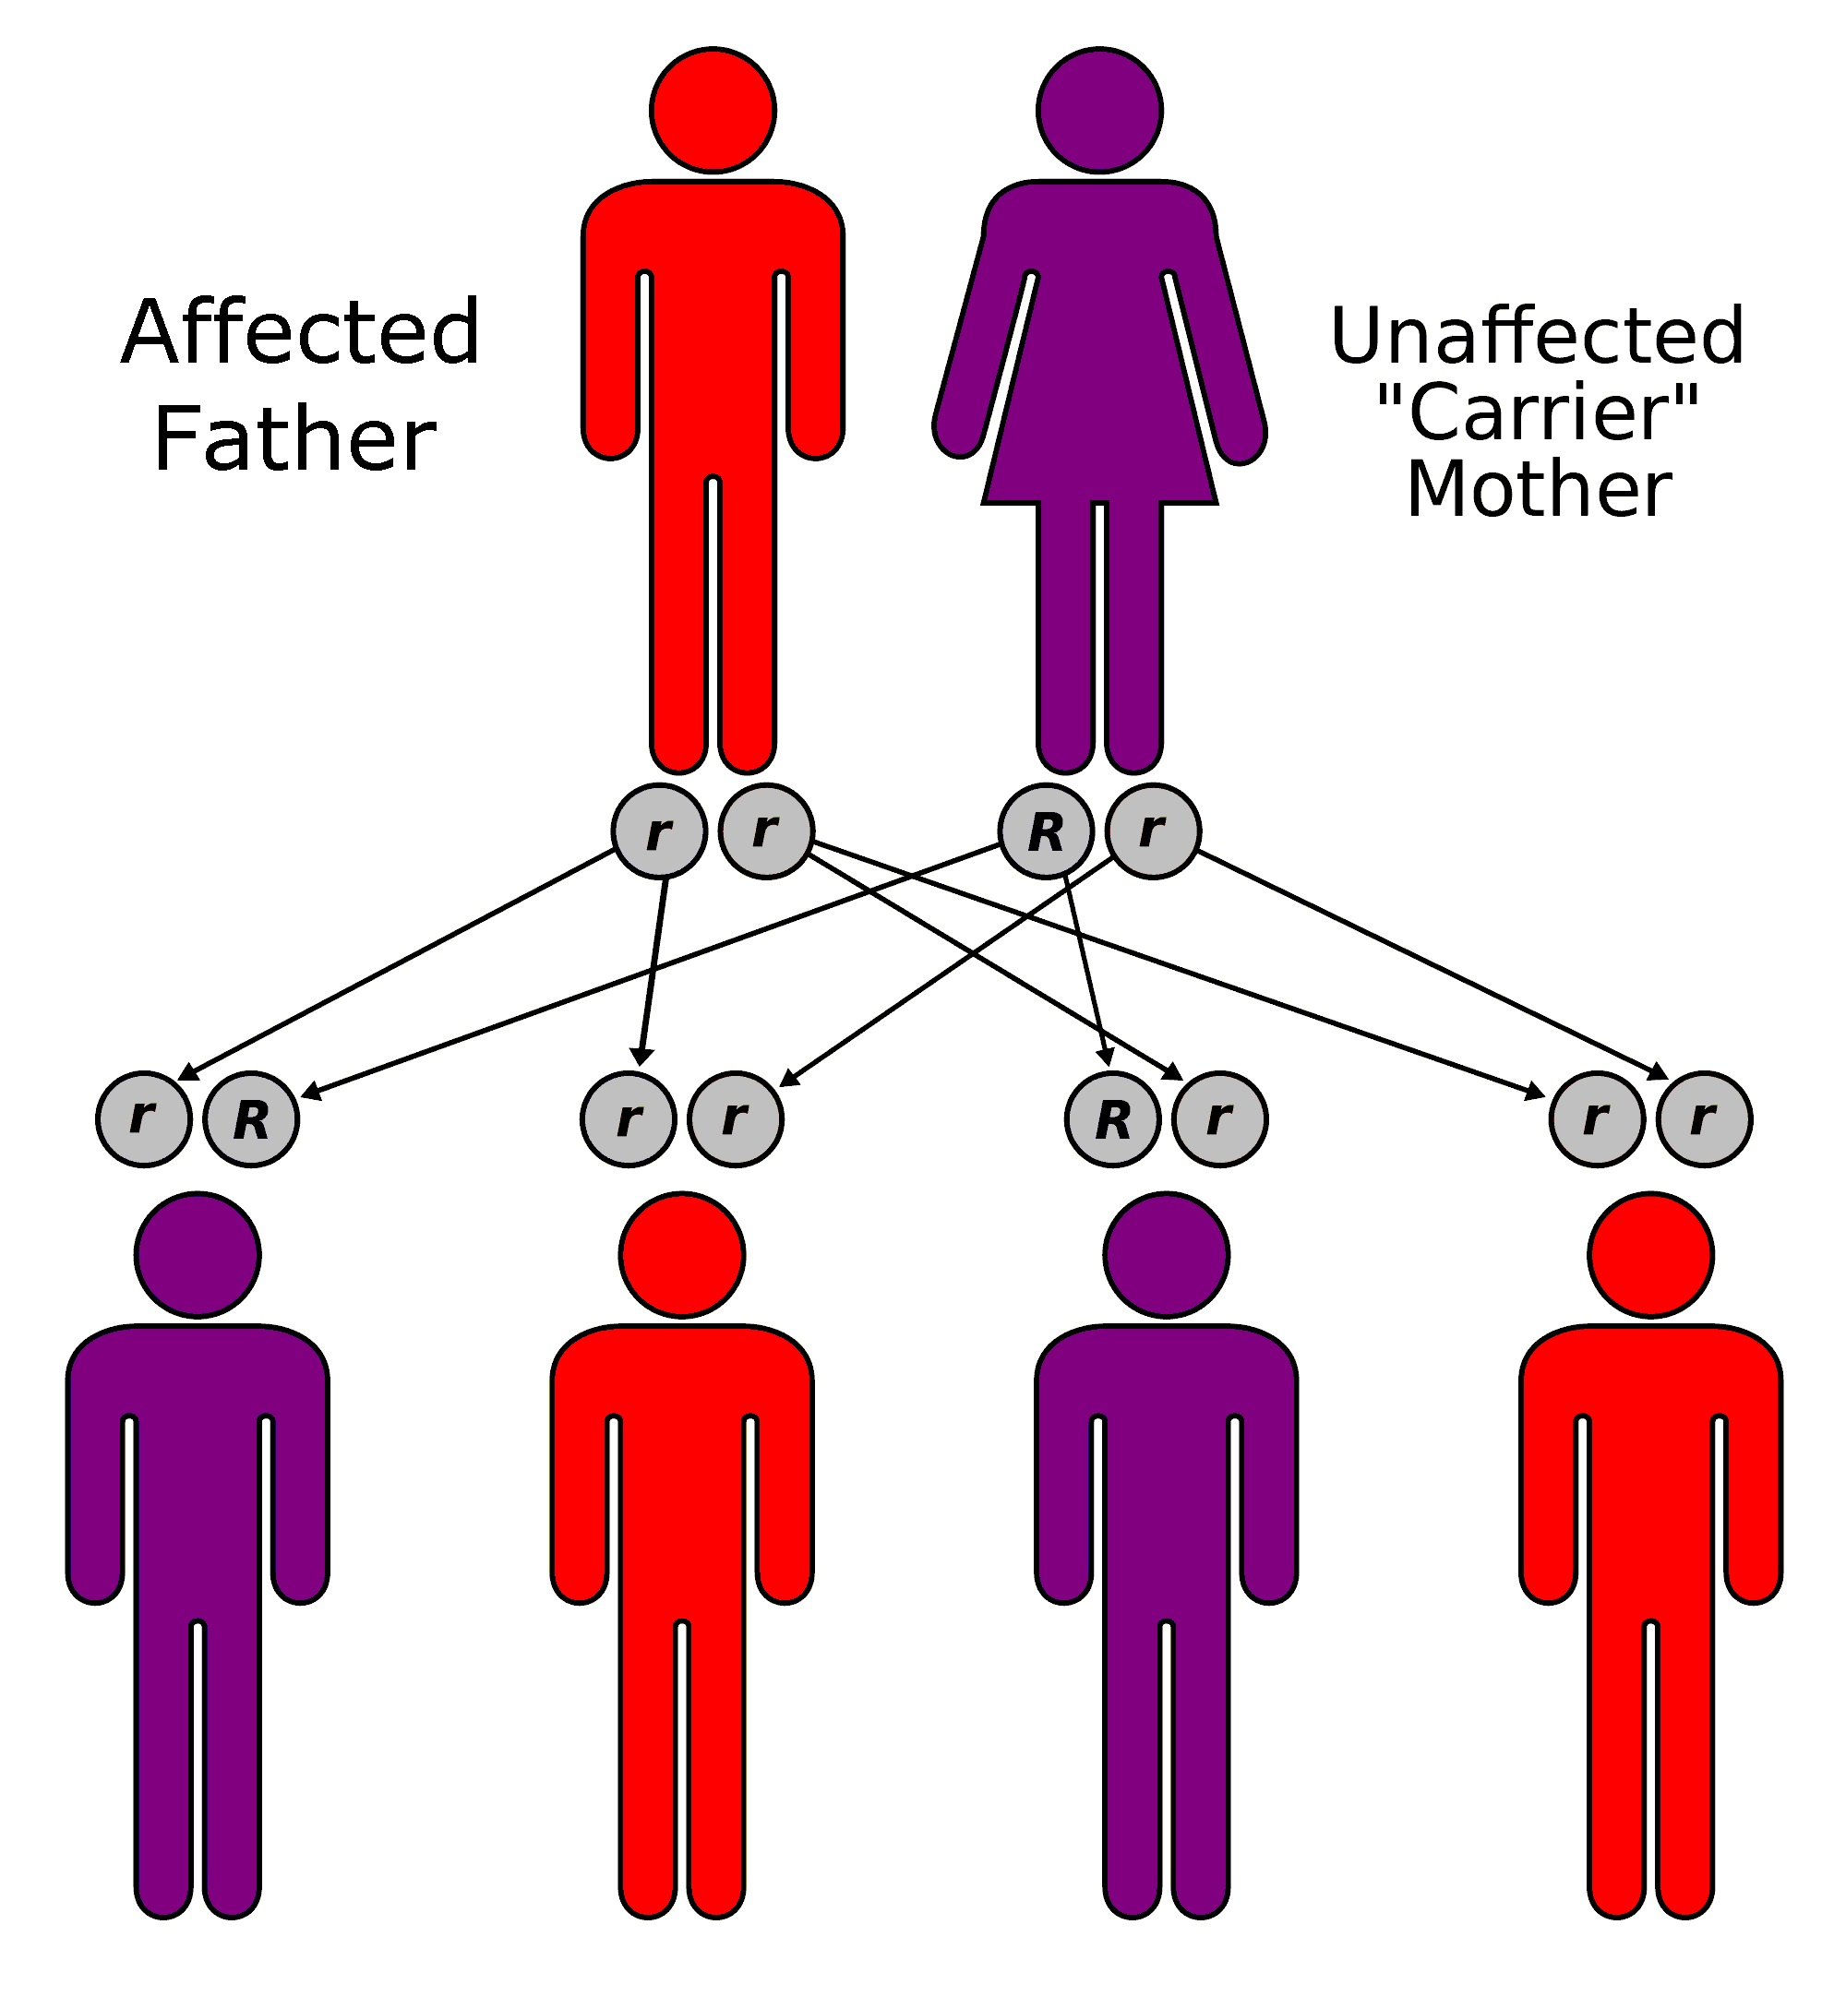
Inheritance
Inheritance is a mechanism that allows one class to inherit properties and behavior of another class. The class that is being inherited is called the superclass, parent class or base class, and the class that inherits is called the subclass or derived class. Inheritance promotes the reuse of code and is a way to model real-world relationships between different entities.

Slide 22
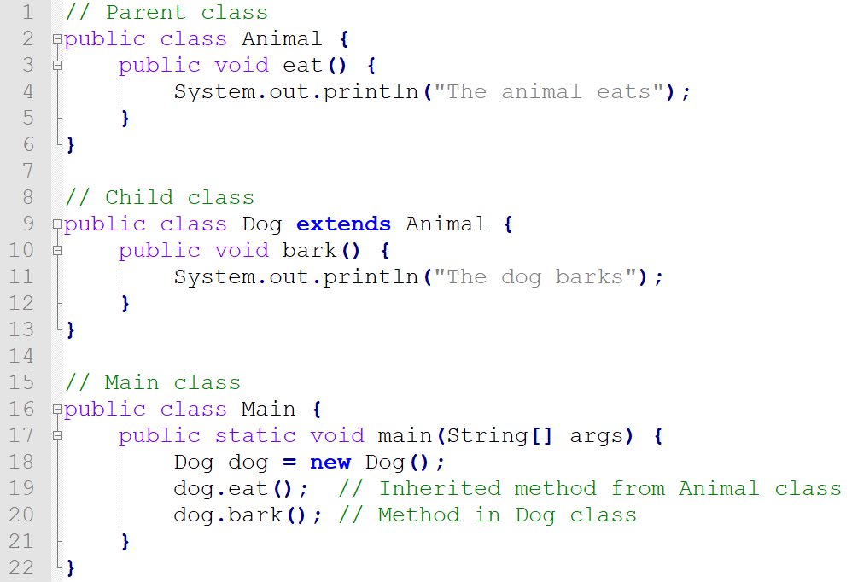
Inheritance
use the extends keyword to implement inheritance

Slide 23
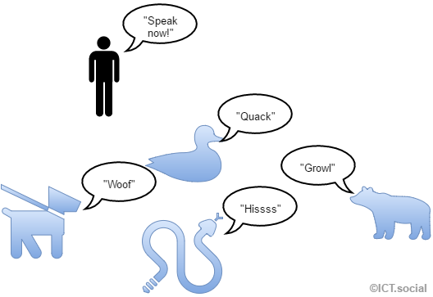
Polymorphism
Polymorphism is the ability in object-oriented programming to present the same interface for differing underlying forms (data types). It allows objects of different classes to be treated as objects of a common superclass, enabling a single method or function to handle various types of objects seamlessly. This aids in creating more flexible and reusable code.

Slide 24
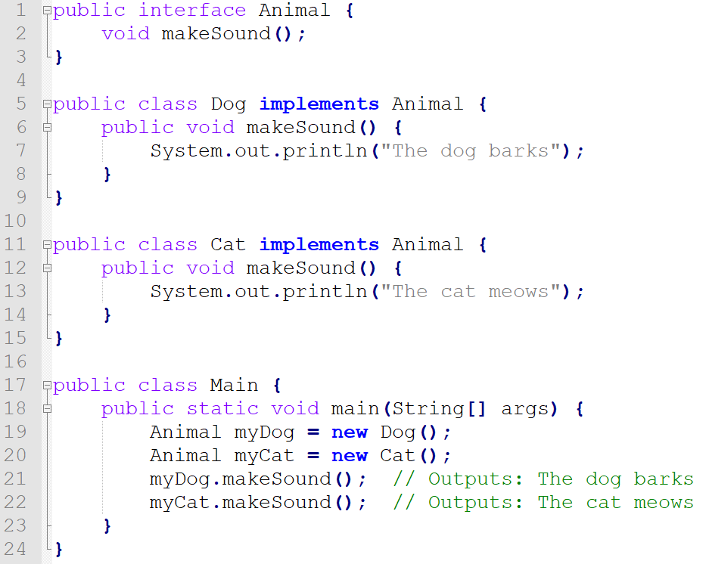
Polymorphism
polymorphism is implemented through interface

Slide 25
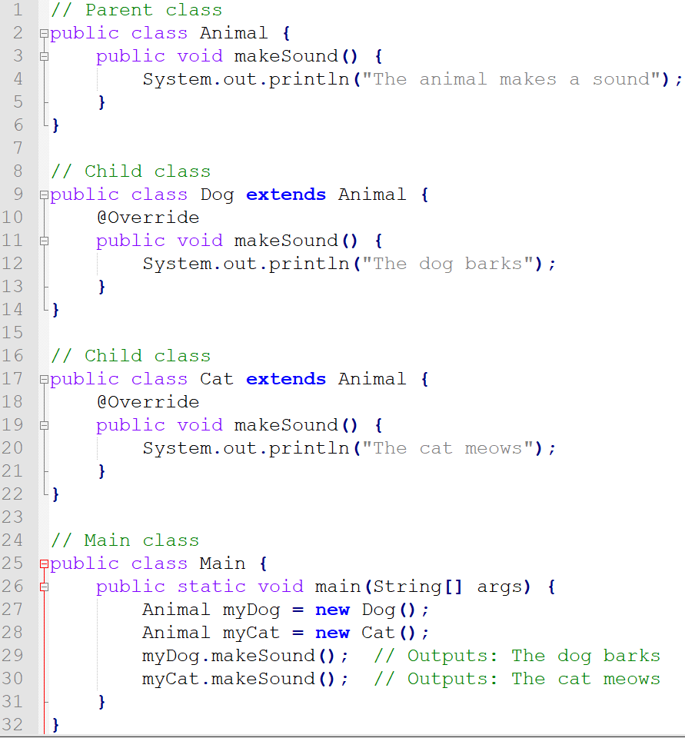
Polymorphism
polymorphism is implemented through method overriding

Slide 26
Recall Questions
What are the keys to the success of a software?
What are the four pillars of OO programming?
What is abstraction? Can abstraction class have concrete method?
Is setting constant into an interface a good practice?
What does inheritance do?
What do we put in the super class?
How to implement encapsulation and how to get the private property ?
What is polymorphism and what does polymorphism do?
How to implement polymorphism ?

Slide 27
What should we do?
S.O.L.D.
SOLID is an acronym representing a set of five fundamental design principles in object-oriented programming and software development. These principles, when followed, make software designs more understandable, flexible, and maintainable.

Slide 28
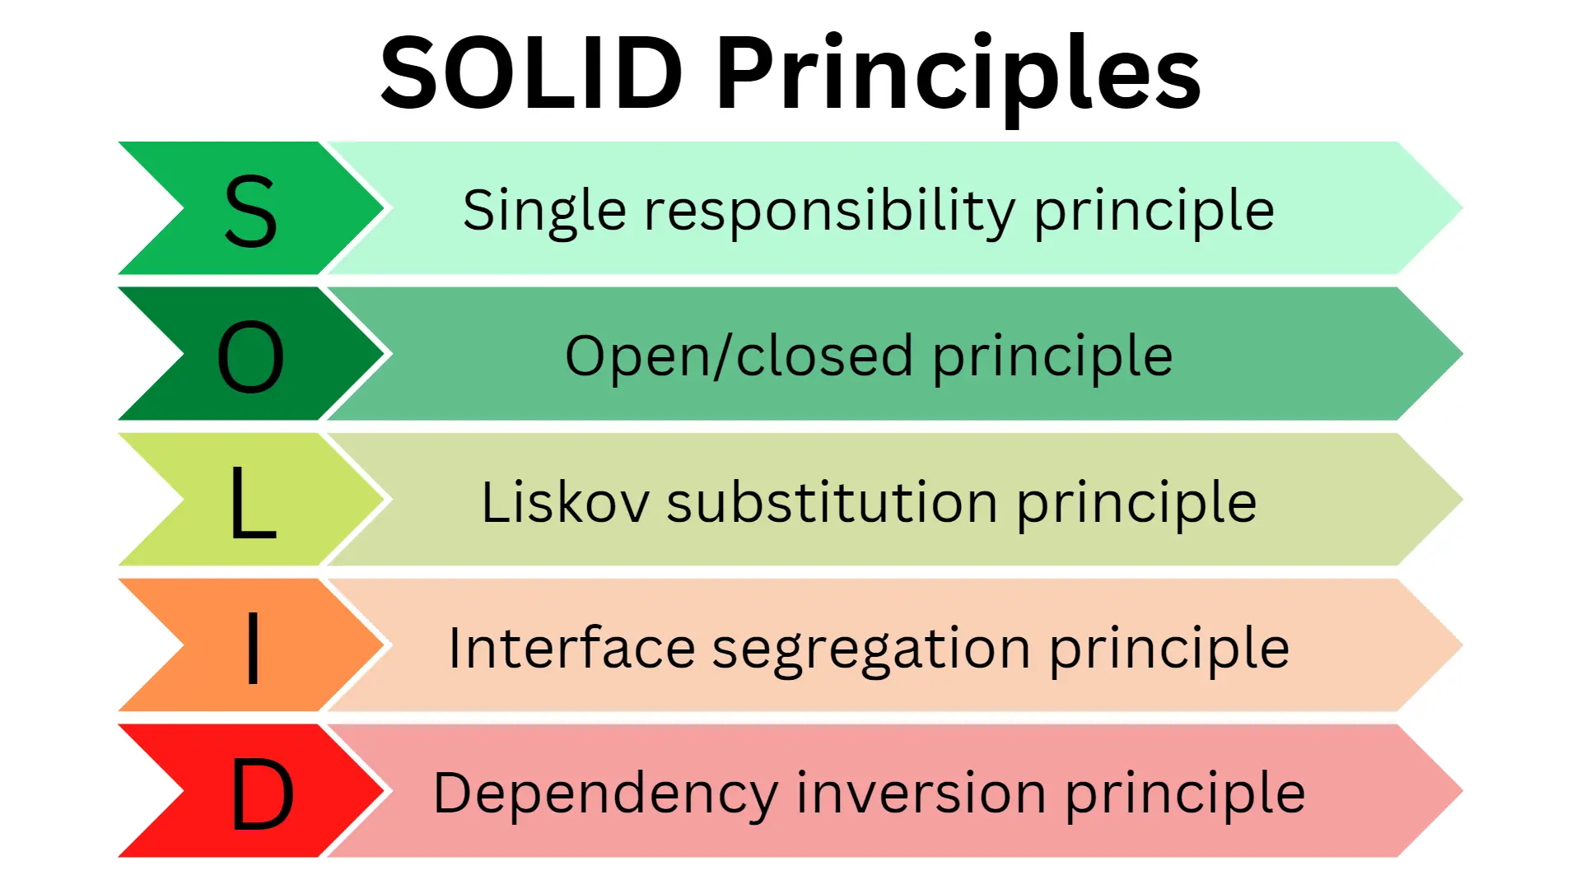

Slide 29
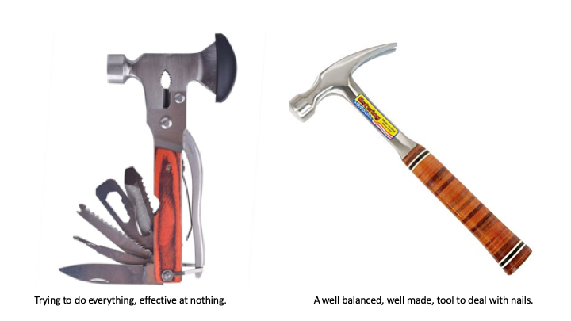
Single Responsibility Principle
“Every module or class should have responsibility over a single part of the functionality provided by the software, and that responsibility should be entirely encapsulated by the class.” - Wikipedia

Slide 30
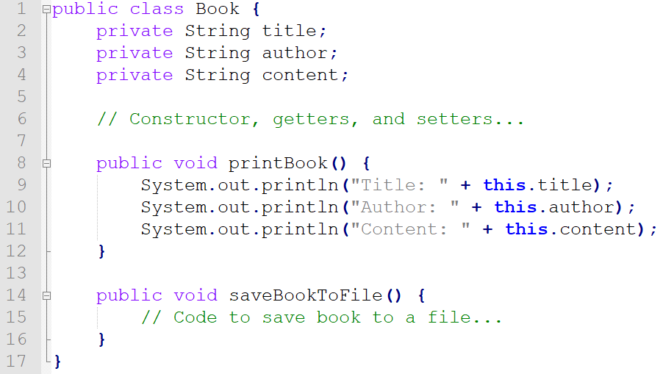
Single Responsibility Principle (Violation example)

Slide 31
Single Responsibility Principle (Common Violations)
Mixing responsibilities: A class or module that handles multiple unrelated responsibilities, making it harder to maintain and understand.
Mixing levels of abstraction: A class or module containing both high-level logic and low-level implementation details, leading to reduced clarity and cohesion.
Inappropriate coupling: Classes or modules that are tightly coupled to multiple other classes or modules, making changes more difficult and increasing the risk of unintended side effects.
Excessive dependencies: A class or module that relies on too many other classes or modules, increasing the complexity and making it harder to maintain and modify.

Slide 32
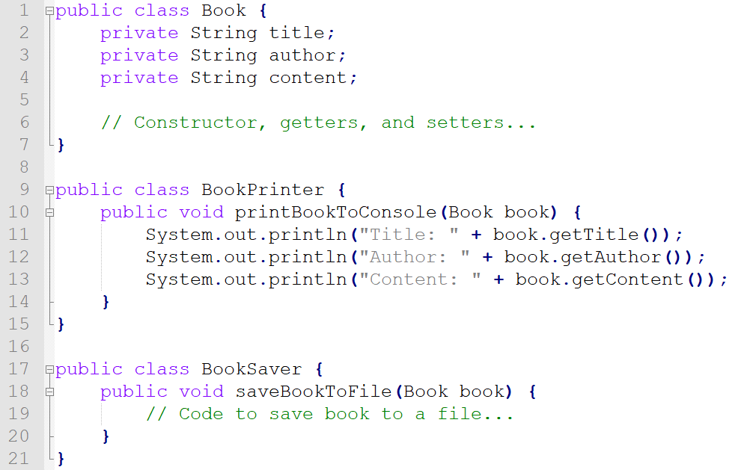
Single Responsibility Principle (Modified)

Slide 33
Single Responsibility Principle (Advantages)
Easier maintenance: Simpler to understand and maintain. Changes made will only impact in a minimum scale, reducing the risk of introducing bugs in unrelated parts.
Improved readability: Code more straightforward for developers to understand, as each class or module is focused on a specific task.
Enhanced testability: When each class or module is responsible for a single task. It's easier to write unit tests and ensure that each part of the system works correctly in isolation.
Better separation of Business Logic: Clear separation of BL in codebase. This Allows developers to work on individual components without affecting others, which is particularly beneficial for large teams or projects.

Slide 34
Single Responsibility Principle (Best Practice)
Break down tasks: Analyze the problem and divide it into smaller, focused tasks before writing the code.
Stay focused: Keep each class or module focused on its main task, avoiding unrelated methods or data members.
Refactor if needed: Split a class or module with multiple responsibilities into smaller, focused units.
Use clear names: Choose descriptive names for classes, modules, and methods to indicate their purpose.
Delegate tasks: Use delegation or composition to offload tasks to other classes or modules, maintaining SRP.

Slide 35
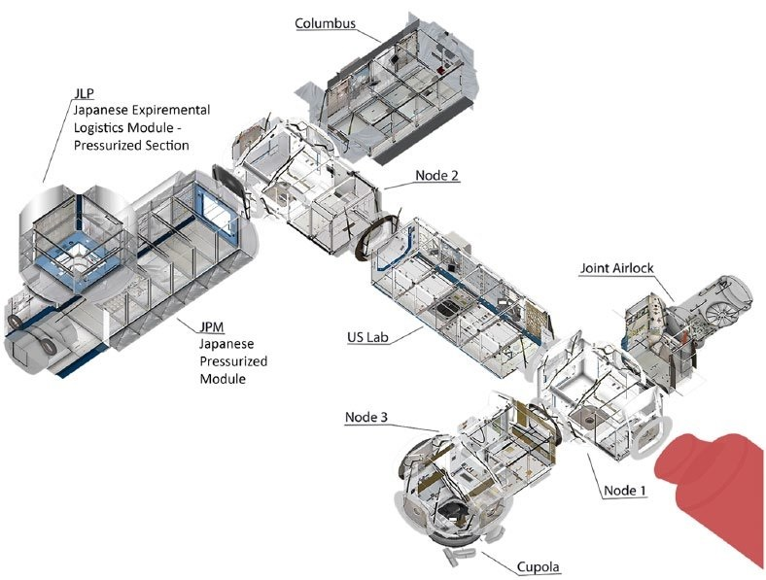
Open/Close Principle
“Software entities (classes, modules, functions, etc.) should be open for extension, but closed for modification” - Object-Oriented Software Construction, Bertrand Meyer

Slide 36
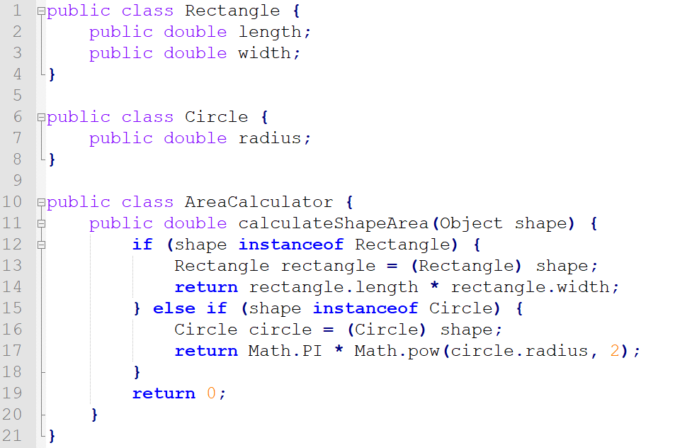
Open / Close Principle (Violation Example)

Slide 37
Open / Close Principle (Common Violations)
Frequent modification: Classes or modules requiring constant changes for new features, indicating insufficient extensibility.
Rigid structure: Design without considering future extensions, making it hard to add functionality without altering existing code.
Lack of abstraction: Absence of interfaces or abstract classes, hindering easy system extension without modifying existing code.
Poor inheritance/composition: Inadequate use of inheritance or composition, leading to modifications instead of creating new components.

Slide 38
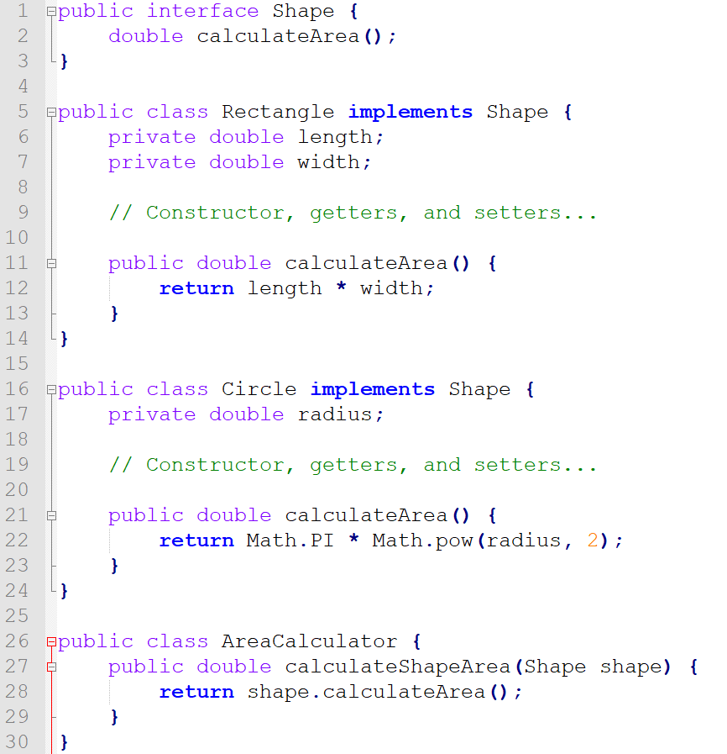
Open / Close Principle (Modified)

Slide 39
Open/Close Principle (How to achieve)
Abstraction: Use interfaces or abstract classes to establish common behaviors, allowing new functionalities by adding new implementing or extending classes.
Inheritance and Overriding: Utilize subclasses to modify the behavior of base classes, facilitating changes by creating new subclasses that override methods as necessary.
Strategy Pattern: This pattern enables algorithm behaviors to be selected at runtime, encapsulating each algorithm and making them interchangeable, promoting flexibility.
Composition over Inheritance: Favor object composition over class inheritance to mitigate issues such as tight coupling and fragile base classes, leading to more adaptable and manageable code.

Slide 40
Open / Close Principle (Advantages)
Maintainability: OCP reduces the risk of introducing bugs by allowing new functionality to be added without modifying existing code, which minimizes unintended side effects.
Reusability: By designing components that can be extended without altering their core implementation, OCP encourages greater reusability, enabling components to be adapted for different purposes.
Modularity: OCP leads to more modular design, making the system easier to understand, maintain, and extend, as each module can be extended without changing its existing behavior.
Flexibility: Increases the flexibility of a software, easily adapting changing requirements or the addition of new features without modifying the existing code.

Slide 41
Open / Close Principle (Best Practices)
Use abstractions: Create interfaces or abstract/base classes to define common contracts, allowing extension without modifying existing code.
Leverage inheritance/composition: Extend classes using subclasses or composition, building new functionality without altering original code.
Utilize design patterns: Implement OCP-supporting patterns like Strategy, Decorator, or Template Method to extend functionality without code modifications.

Slide 42
Open / Close Principle (Best Practices Cont.)
Plan for extensibility: Design components considering future extensions, making it easier to accommodate changes without code modifications.
Encapsulate varying behavior: Identify frequently changing code parts, encapsulate them behind stable interfaces, allowing modifications without affecting the system.
Favor composition over inheritance: Use composition for extending functionality, often resulting in more flexible and maintainable code than inheritance.

Slide 43
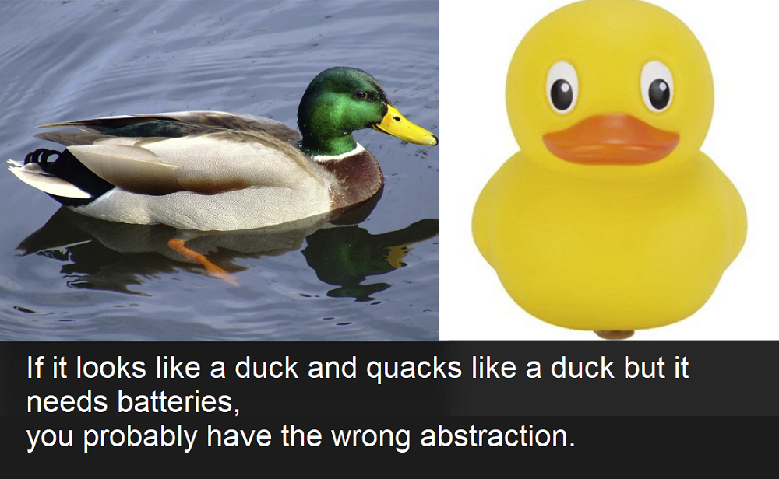
Liskov Substitution Principle
“Objects in a program should be replaceable with instances of their subtypes without altering the correctness of that program.” - Wikipedia

Slide 44
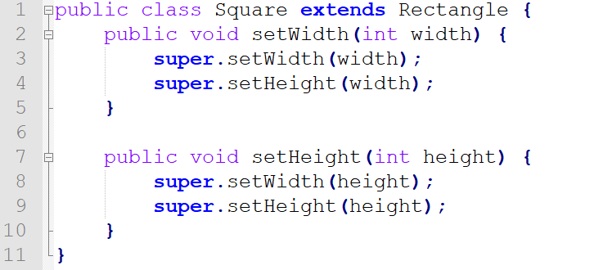
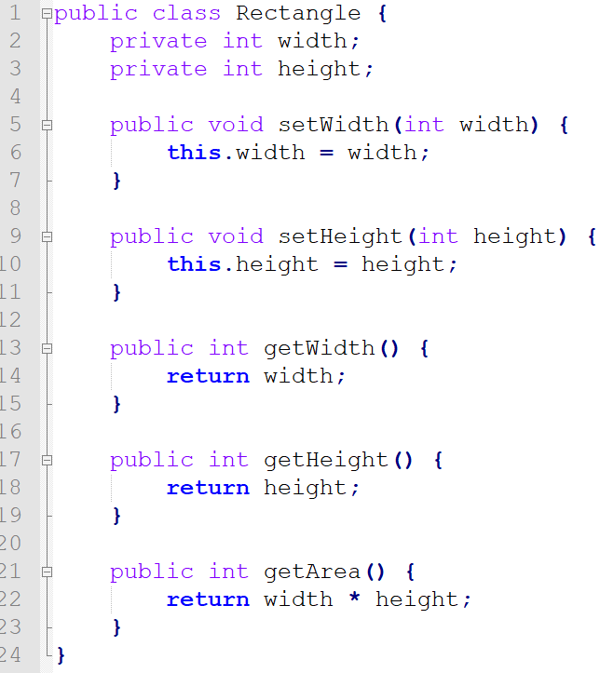
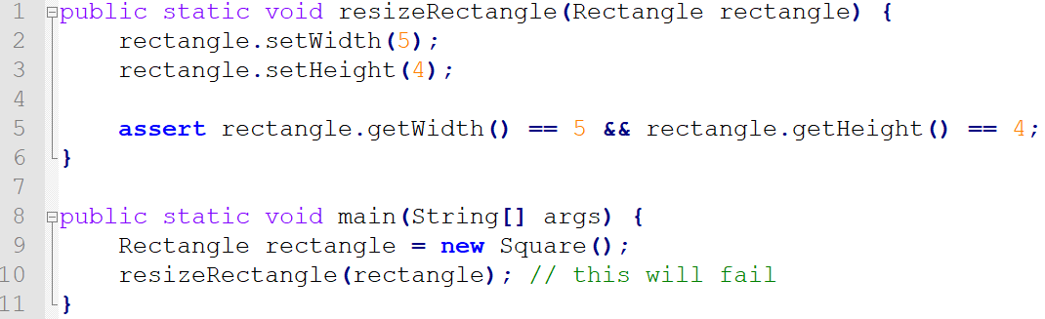
Liskov Substitution Principle (Violation Example)

Slide 45
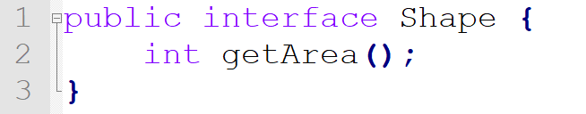
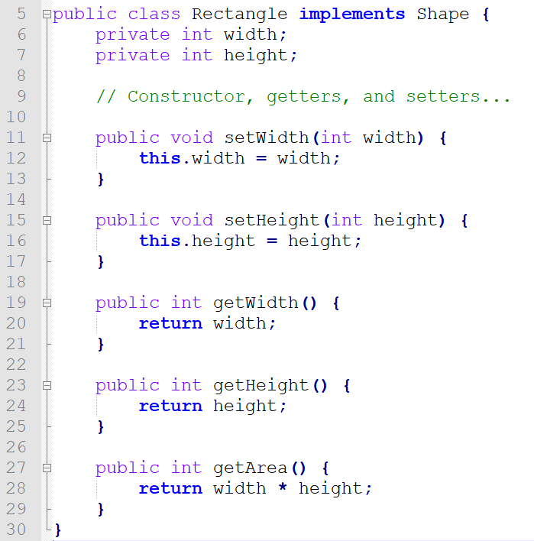
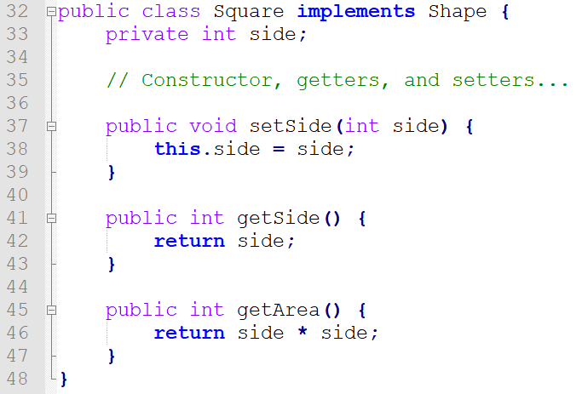
Liskov Substitution Principle (Modified)

Slide 46
Liskov Substitution Principle (Avoid Violation)
Preserving Functionality: Any method in a derived class should not alter the functionality of the base class. It may extend the functionality, but should not reduce it.
Favor composition over inheritance: Use composition when inheritance may violate LSP, providing greater flexibility and avoiding issues from improper inheritance.
Use proper method signatures: Match method signatures in derived classes with base class signatures, allowing derived classes to seamlessly replace base classes.

Slide 47
Liskov Substitution Principle(Best Practice)
Avoid overloading methods inappropriately: Exercise caution when overloading methods in derived classes, preventing LSP violations due to unexpected base class behavior changes.
Preserve method semantics: Maintain the same purpose and behavior when overriding or implementing methods in derived classes as in the base class.
Enforce the "is-a" relationship: Ensure derived classes represent a more specific version of the base class, following the "is-a" relationship.

Slide 48
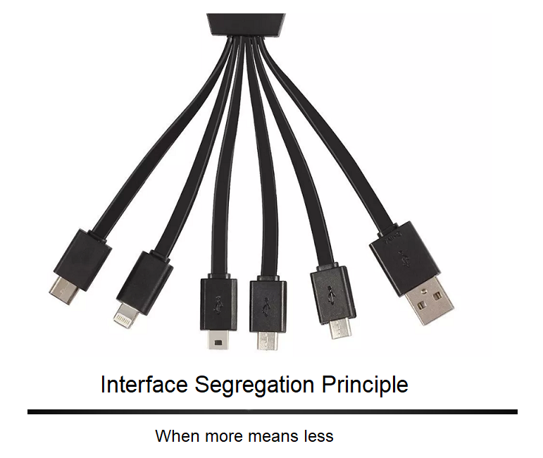
Interface Segregation Principle
“No client should be forced to depend on methods it does not use.” - Wikipedia

Slide 49
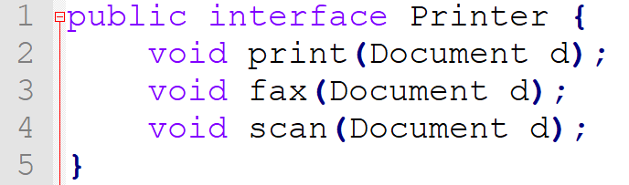
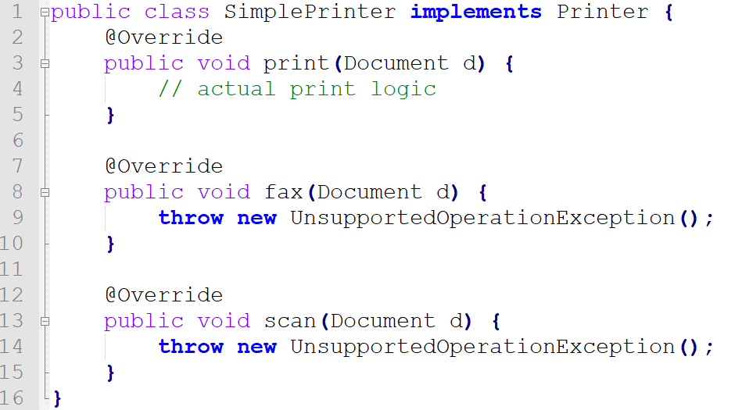
Interface Segregation Principle (Violation Example)

Slide 50
Interface Segregation Principle (Common Violations)
Large interfaces: Creating interfaces with many methods, forcing clients to depend on methods they do not use.
Lack of focused interfaces: Not segregating interfaces based on specific client needs, leading to increased coupling and reduced maintainability.
Forcing unrelated implementations: Clients implementing interfaces containing unrelated methods, making the system rigid and less modular.

Slide 51
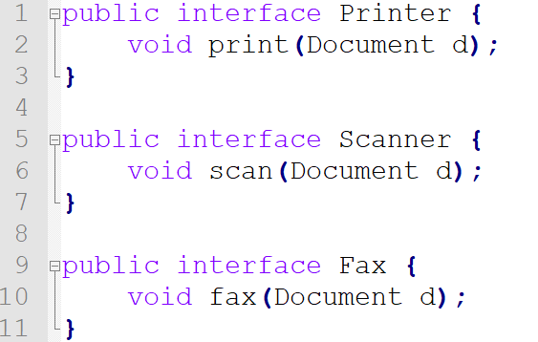
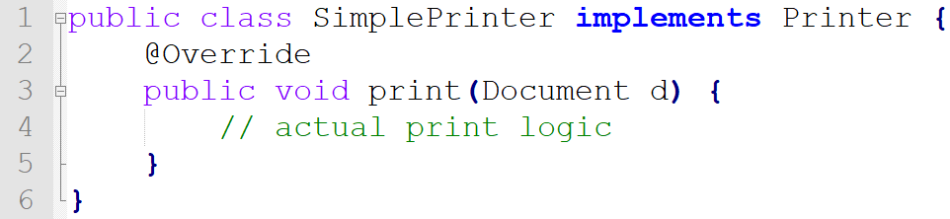
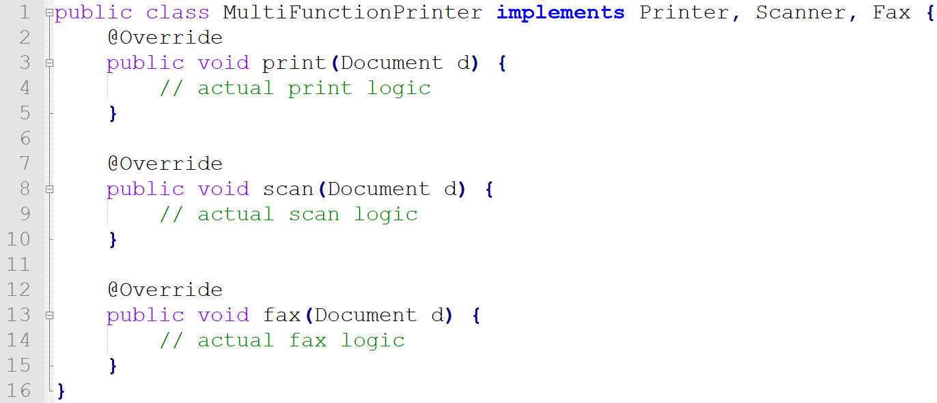
Interface Segregation Principle (Fixed)

Slide 52
Interface Segregation Principle (Best Practices)
Identify client-specific responsibilities: Analyze the requirements and responsibilities of each client and create focused interfaces that cater to their specific needs.
Keep interfaces small and focused: Design interfaces with a limited number of methods that are relevant to the clients using them, promoting separation of concerns.
Separate unrelated functionalities: Avoid grouping unrelated methods within the same interface. Instead, create separate interfaces for distinct functionalities.

Slide 53
Interface Segregation Principle (Best Practices Cont.)
Use composition over inheritance: When possible, prefer composition to create flexible and modular systems, allowing clients to use only the interfaces they need.
Leverage dependency inversion: Depend on abstractions rather than concrete implementations, making it easier to swap or modify components without affecting the clients.
Refactor existing interfaces: Regularly review and refactor existing interfaces to ensure they remain focused and adhere to ISP as the system evolves.

Slide 54
Interface Segregation Principle (Advantages)
Enhanced maintainability: Smaller, focused interfaces make it easier to maintain and update code without unintended side effects.
Improved reusability: Segregated interfaces promote code reusability, as components can be easily reused in different contexts with minimal dependencies.
Reduced coupling: ISP reduces coupling between components, leading to more modular and flexible systems that are easier to modify and extend.
Increased code readability: Focused interfaces with clear responsibilities improve code readability and make it easier to understand the system's design.
Greater flexibility and adaptability: Adapt more easily to changing requirements by minimizing the impact of changes on dependent components.

Slide 55

Dependency Inversion Principle
High-level modules should not depend on low-level modules; instead, both should depend on abstractions. Furthermore, abstractions should not depend on details; details should depend on abstractions

Slide 56
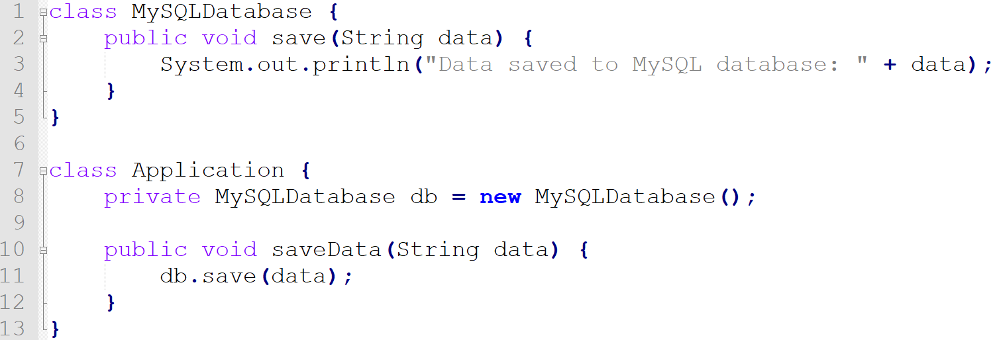
Dependency Inversion Principle (Violation Example)

Slide 57
Dependency Inversion Principle(Common Violations)
High-level modules depending on low-level modules: High-level components directly relying on concrete low-level implementations, increasing coupling and reducing flexibility.
Abstractions depending on details: Abstractions, such as interfaces, containing implementation details, leading to reduced modularity and maintainability.
Insufficient abstraction: Not using abstract classes or interfaces to define contracts between components, hindering the ability to swap implementations.
Tight coupling: Components that are tightly coupled due to direct dependencies on concrete implementations, making the system rigid and hard to change.

Slide 58
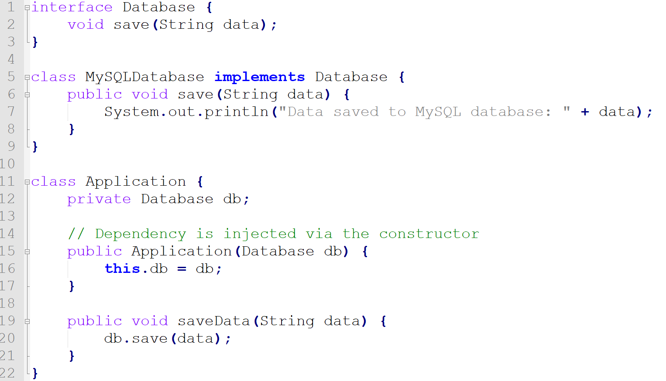
Dependency Inversion Principle (Fixed)

Slide 59
Dependency Inversion Principle(Advantages)
Reduced coupling: DIP promotes modular systems, simplifying modifications and extensions by lowering component coupling.
Increased maintainability: DIP's reliance on abstractions minimizes the impact of low-level module changes on dependent components.
Improved flexibility: DIP enables easy substitution of implementations, increasing adaptability to new requirements or technologies.
Better testability: Abstraction dependencies simplify unit testing with mock implementations, without modifying actual components.
Scalability: DIP facilitates system scaling by allowing component additions, updates, or replacements without affecting the whole system.

Slide 60
Dependency Inversion Principle(Best Practices)
Use abstractions: Rely on interfaces or abstract classes to define contracts between components, allowing for easier substitution of different implementations.
Apply dependency injection: Use dependency injection techniques (constructor, setter, or interface injection) to provide the required dependencies, promoting flexibility and testability.
Leverage inversion of control (IoC) containers: Utilize IoC containers to manage dependencies and automatically wire components together, simplifying the process of applying DIP.

Slide 61
Dependency Inversion Principle(Best Practices Cont.)
Adhere to the Interface Segregation Principle (ISP): Create focused, small interfaces that cater to specific client needs, which helps in maintaining a clean dependency structure.
Design for modularity: Organize your code in a modular manner, separating responsibilities and concerns, which makes it easier to apply DIP.
Refactor and review: Regularly review and refactor code to ensure dependencies are properly inverted and components depend on abstractions rather than concrete implementations.

Slide 62
Dependency Inversion Principle (Continued…)
You can go to the extreme:
All member variables must be interfaces or abstracts
All modules must connect only through interface or abstract classes
No class should derive from a concrete class
No method should override an implemented method
Creational patterns for member variables
Mediocre programmers will not follow these rules, too much work and too hard for them

Slide 63
Dependency Inversion Principle (Continued…)
You can go middle of the road:
Modules interact through interfaces / abstractions
No class should derive from a concrete class
Use creational patterns
You can do a little, and if you grow to like it, escalate:
Modules interact through interfaces / abstractions, this is the minimum

Slide 64
Project & S.O.L.I.D.
All classes your team writes for your project must adhere to the S.O.L.I.D. principles
An assignment will further test your knowledge of S.O.L.I.D. by:
Getting you to create some bad classes.
Getting you to fix those bad classes and turn them into good classes.
Asking you to explain why the classes were bad, and how your fix makes them good.

